Slide 1
caGrid:
An Introduction
A Tool Demonstration from caBIG™

Slide 2

The Grid in Context
Notes:
These scenarios will be solved later in the deck

Slide 3

What is caBIG?
Common, distributed infrastructure that permits the research community to focus on innovation
Shared, harmonized set of terminology, data elements, and data models that facilitate information exchange
Collection of interoperable applications developed to common standards
Cancer research data available for mining and integration

Slide 4
What is caGrid?
Lesson 6: Focusing on the Grid
caGrid (or the “Grid”) provides the core infrastructure and tooling needed to connect to the Grid in a distributed manner - this is the ultimate target of the compatibility process.
It is a…
  grid based software infrastructure consisting of services, toolkits and Application Programming Interfaces (API)
  production grid deployment of the core services provided by that infrastructure
  community of developers leveraging that grid and infrastructure to provide applications and services to the cancer research community
“Getting something on the Grid” – or “establishing a Grid node” - means meeting requirements for interoperability (through adoption or adaptation), and then connecting that interoperable data or analytical service to the production Grid.
Grid services are “advertised” through index service, which is part of the production grid infrastructure. You can also connect to the index service to “discover” services provided by others.

Slide 5

What is caGrid to caBIG?
The “G” in caBIG
  Cancer Biomedical Informatics Grid
Provides the software foundation which underlies the tools and applications of caBIG
Analogous to the “power grid”, but without the wires
  A multitude of applications with differing requirements can seamlessly be plugged in to a common infrastructure

Slide 6
caGrid Community Involvement
caGrid itself provides no real “data” or “analysis” to caBIG™; it’s the enabling infrastructure which allows the community to do so
Community members add value to the grid as applications, services, and processes (for example: shared data services)
  caGrid provides the necessary core services, APIs, and tooling
The real value of the grid comes from bringing this information to the end user
Community members develop end user applications which consume of the resources provided by the grid

Slide 7
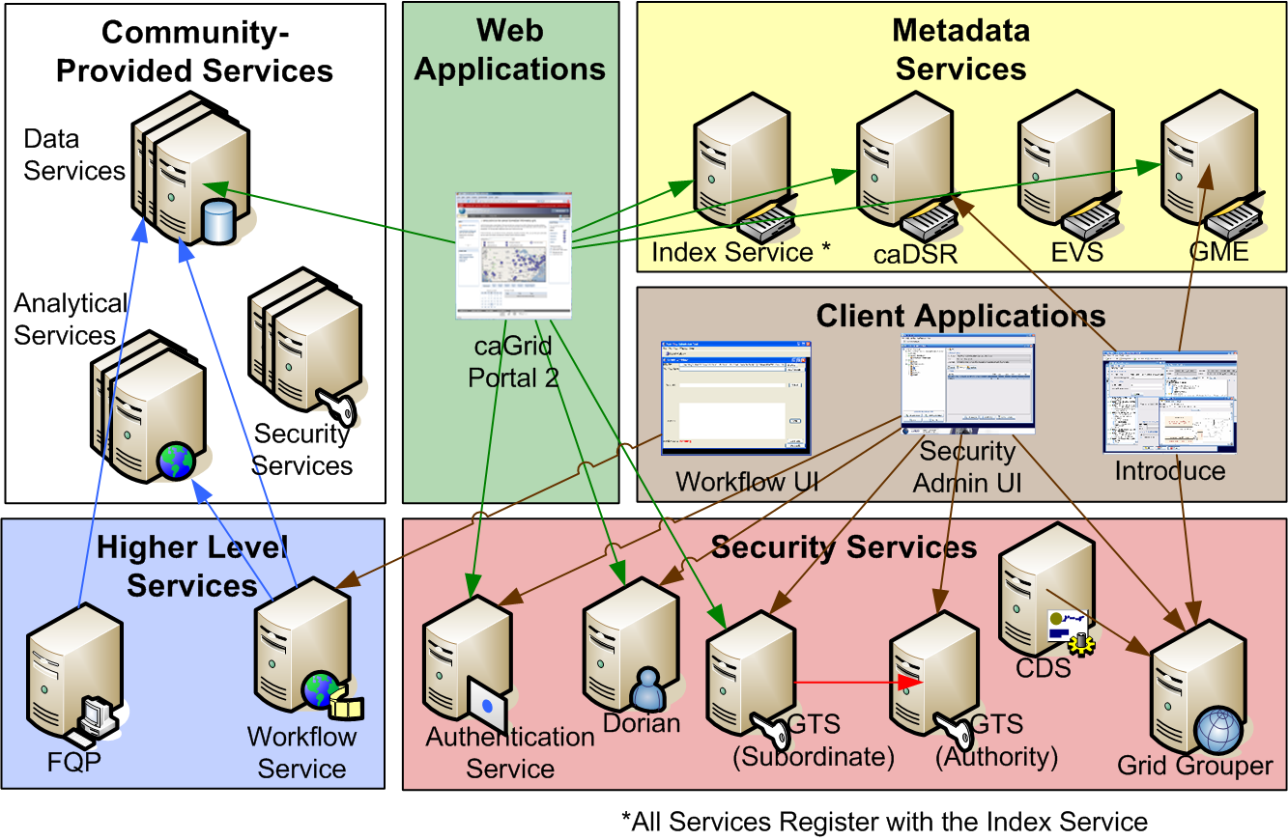
caGrid Infrastructure & Tooling:
High Level View
Ultimately, the Grid consists of a collection of applications and services, connected to each other through a secure infrastructure.
Source: www.cagrid.org

Slide 8
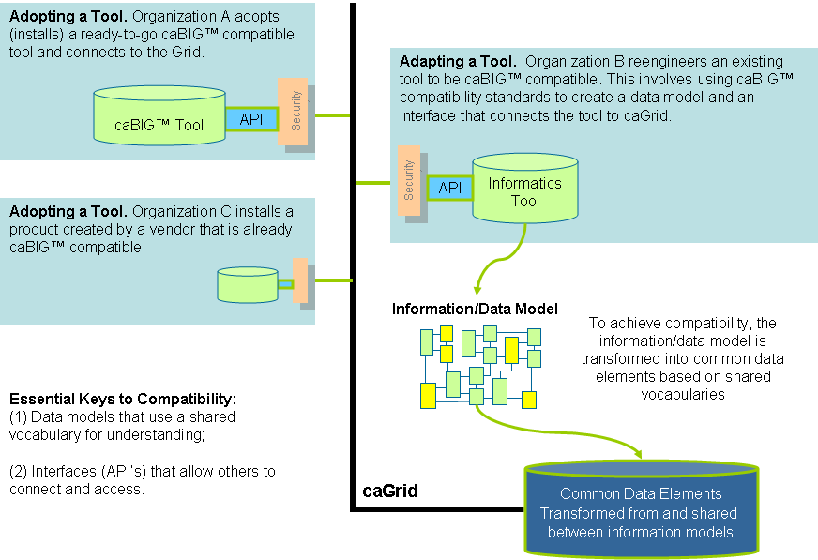
A Summary Conceptual View:
How It All Fits Together

Slide 9
Infrastructure Focus Areas
Leveraging Grid technologies and standards as an interoperability platform
Metadata Infrastructure
  Surfacing wealth of existing caBIG™ data-oriented metadata on the grid
  Providing new service-oriented metadata
Security
  Integrating existing systems and applications with Grid security
  Lowering burden of implementation of grid-wide and local policy
Service Developer Tooling
  Powerful platform for bringing applications and data to the grid
Facilitating Grid wide operations
  Federated query, workflow execution, resource discovery
Making the Grid more accessible
  Graphical installation and configuration, higher-level object-oriented APIs, web portals, graphical administrative applications
Quality
  Comprehensive testing infrastructure, automated builds and test execution on multiple platforms, dashboard with historical archive

Slide 10
Getting on the Grid:
Key Requirements
You cannot “get your tool on the Grid” unless you have:
  Adopted or adapted a tool that is caBIG™ compatible
  Installed caGrid software.
To Grid-enable a system (expose a compatible tool on the Grid) you must:
  Use Strongly Typed Objects that are part of information models registered in the Cancer Data Standards Repository (caDSR).
  Develop object oriented APIs to access data resources.
  Define a Grid service interface over the object oriented APIs that defines the functionality that you are exposing to the Grid. This grid service interface uses the same strongly typed objects as your existing system, but represents them in way that is platform and language neutral (using XML) based on registered schemas.
  Complete Grid service implementation by mapping service invocations to API calls into the existing system
  All of these activities are enabled through caGrid tools and infrastructure – adopting a caBIG™ compatible tool means much of the work has already been done for you – adaptation may take more effort.

Slide 11
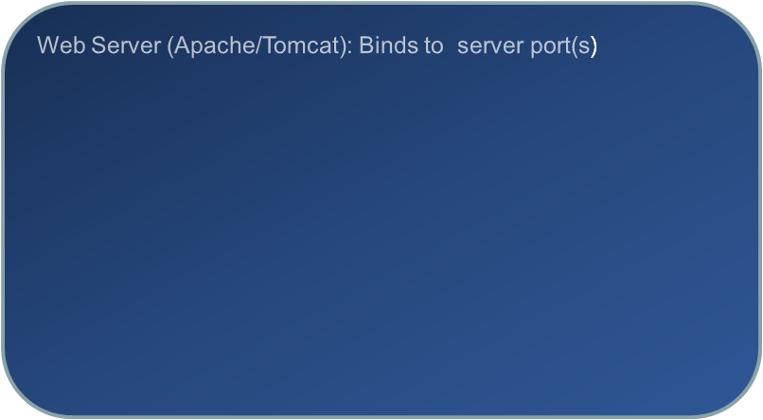
Physical View of a Grid Node
Grid Service Client API
HTTP/HTTPS
Web Application Server (JBoss/Tomcat): Hosts the web applications connected to the web server
SOAP
Globus Web Application
Grid Service
Application
Database

Slide 12
Final Notes on Grid Services & APIs
Invoking Operations on a Grid Service
  To query any caGrid Data Service, a common grid client API can be used, regardless of the type of data it exposes. Applications built to query data services generally would build against this API. For Analytical Services, however, it is more likely a client API specific to a type of analytical service would be used, and, again, instances of that service would be bound to it at runtime. In both cases, the application developer would just make use of a pre-provided client API.
Dynamic Invocation for Workflows
  Constructing a workflow is one instance where a client or application may wish to invoke operations on a service without having previously downloaded a client API.
  The caGrid workflow infrastructure provides the mechanism to describe service invocations using a workflow language (BPEL), and executing the grid services.
  Further details on the workflow infrastructure can be found in the caGrid 1.1 Programmer’s Guide.
Source: caGrid 1.1 User’s Guide, pgs. 44-45

Slide 13
User Scenarios
A researcher is studying human BRCA1 gene and wants to find information available in public resources on protein encoded by this gene
Patient A enters the clinic. What treatments were applied with success on other patients with similar characteristics (race, sex, symptoms, pathology results, adverse events, biomarkers)?
Notes:
These scenarios will be solved later in the deck

Slide 14
The Grid Tools
Notes:
These scenarios will be solved later in the deck

Slide 15
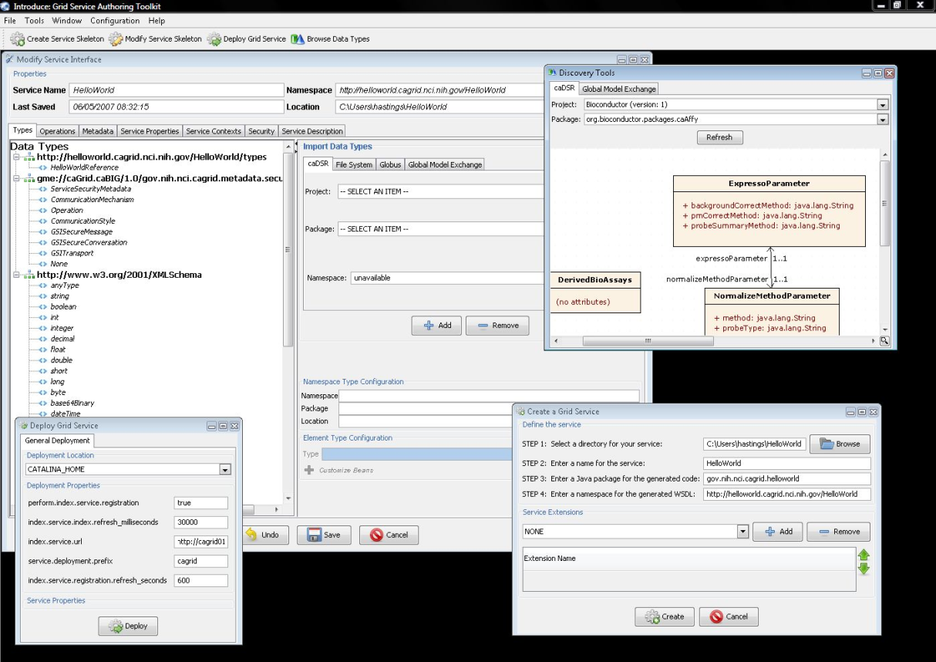
Introduce Graphical Development Environment (GDE)
GUI for creating and manipulating a grid service
  Adding Operations
  Removing Operations
  Updating Operations
  Importing Operations
Graphical Configuration
  Advertisement
  Security
  Service metadata specification
  Service metadata editing
  Service configuration properties
Auto Generates Code for Grid Service
Auto generates a client API for service
Graphical Deployment of Service
  Tomcat
  JBoss
  Provides means of simple creation of service skeleton that a developer can then implement, build, and deploy
  Automatic code generation of complete WSRF compliant grid service which is configured to provide:
    Security
    Advertisement
    Discovery
    Complete UnBoxed Client API
  Provides a set of tools which enable the developer to add/remove/modify/import methods of the service as well create sub-services/resources.
    Automatic code generation of all the required code, Globus grid service code/configuration, service configuration, implementation of the client, and stubbed implementation of the service

Slide 16
What About Security?
Lesson 6: Focusing on the Grid
caGrid provides security using the GAARDS Framework which consists of several components to provide enterprise wide security management and administration
  Dorian allows institutions to integrate local security domains onto caGrid.
  Grid Grouper provides group based data access management services for administrators.
  Trust Service supports the creation and management of federated trust fabric.
  Authentication Service integrates existing credential providers to the grid
  Credential Delegation Services provides ability to delegate credentials to other services/users on behalf of users
  Web Single Sign-On provides single sign-on capability for web based applications which interact with the grid
  Common Security Module supports the enforcement of local data access control based on group membership
The following figure shows how this all fit together to form a security architecture.

Slide 17
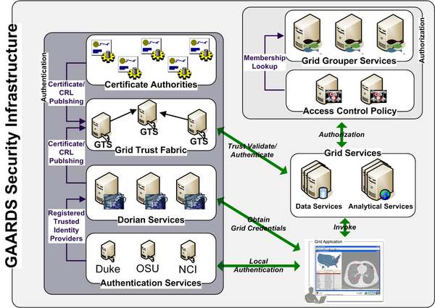
caGrid GAARDS Security
Lesson 6: Focusing on the Grid
For Explanatory Content Visit: GAARDS Wiki OR caGrid 1.1 Users Guide, Figure 6-1, pg. 60

Slide 18
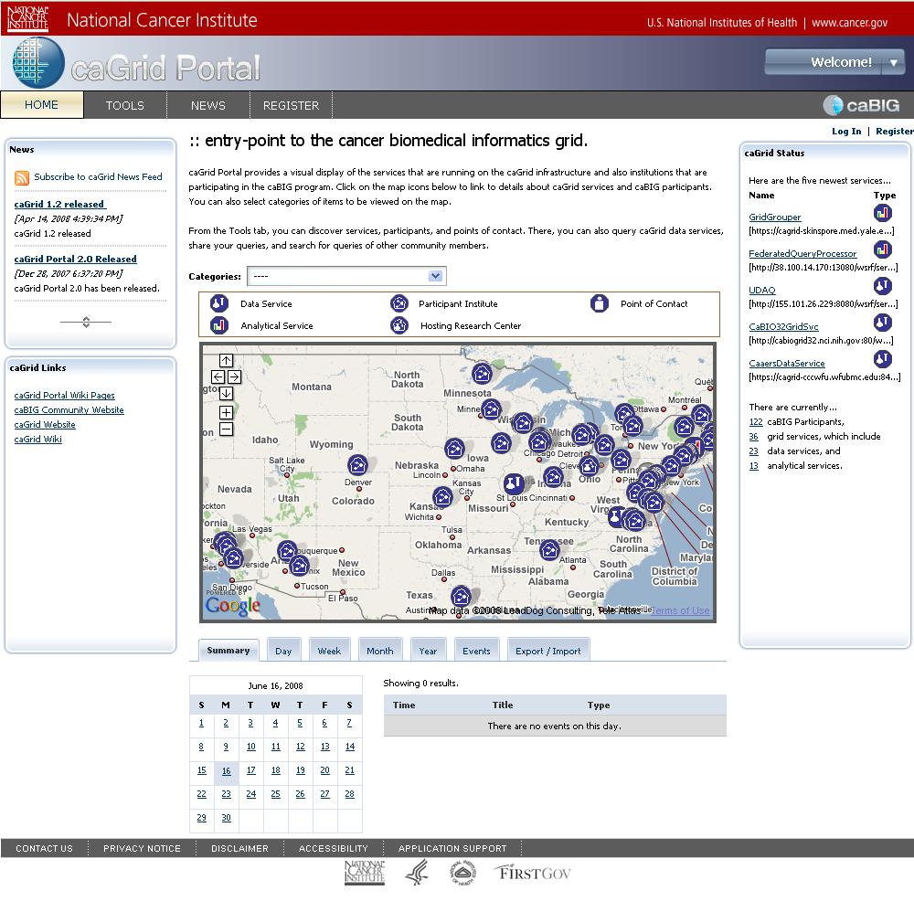
Portal 2
Created as a full-featured replacement for previous caGrid web applications
  the primary visualization tool for the caGrid middleware
Features:
  Service Discovery
  Service Metadata Exploration
  Data Service Query
  Query Sharing
  caGrid Account Registration
  Grid Status Overview
  News and Events

Slide 19
Next Steps
Notes:
These scenarios will be solved later in the deck

Slide 20
Who needs to be involved/convening a team
Need 2 each from Grid deployment and Grid Knowledge Center on this topic– who and what capabilities are required?

Slide 21
Grid Addendum: Case Study
Lesson 6: Focusing on the Grid
The following slides present the Patient A case study, which is related to building a Grid service. The example relies on caTRIP (Cancer Translational Research Informatics Platform), a platform created by Duke University during the caBIG™ pilot.
The case study demonstrates the technologies needed for a GUI-based client to perform queries across multiple grid services. The current version can perform cross-database joins using de-identified medical record numbers.
Case Study Focus:
  Connecting existing data systems, including basic science data, to enhance patient care
  Initial problem scenario is on outcome analysis: Use data from existing patients to inform the treatment of another patient, leveraging clinical, pathology, tissue, and basic science data
  Scenario: Patient A enters the clinic. What treatments were applied with success on other patients with similar characteristics (race, sex, symptoms, pathology results, adverse events, biomarkers)?
We are grateful for slides from Patrick McConnell at Duke Comprehensive Cancer Center.
Notes:
Remember the “Patient A” scenario from earlier? Here’s how caGrid makes answering that question happen.

Slide 22

caTRIP In-depth Architecture
Lesson 6: Focusing on the Grid
Core Grid Service
GUI
query
Federated
Query
Processor
authenticate
discover
Core Grid Services
Domain Grid Services
IdP
Service
Index
Service
Grid
Grouper
authorize
caTissue
CORE
caTIES
CAE
TR
CGEMS
SNP
Duke
Domain
Controller
caTissue
CORE
caTIES
CAE
TR
caIntegrator
MAW3
Tumor Registry
Illumina
Source: caTRIP: A translational tool in action – caTRIP_icr_2007_05.ppt

Slide 23
A Scientific User Scenario – Details
A researcher is studying human BRCA1 gene and wants to find information available in public resources on protein encoded by this gene.
Reading carefully:
Multiple “resources”
“Gene” and “Protein” concepts
A specific “human” gene with name “BRCA1”
Notes:
Remember the BRCA1 scenario from earlier?
How can one find multiple resources?
How can one find info on things like “Gene”/”Protein”?
How can one query resources with restrictive criteria?

Slide 24
caBIG™ Translation of the User Scenario
Discover multiple caGrid Data Services providing Protein information
  Use caGrid Discovery Client
Find how to combine the information from these Data Services
  Find semantically equivalent data elements (Common Data Elements) from different data services
Identify/query the Protein corresponding to BRCA1 gene
  Run caBIG™ queries using caGrid Data Service Client
Collect information on the same protein from different resources
  Run multiple or federated queries against different Data Services leveraging Common Data Elements
All of these steps should be implemented in an automated fashion, either in software directly or in workflow systems like Taverna, etc.
Notes:
If we detail the steps to meet help this user:

Slide 25
Future Plans:
Expanding the Support Network
caGrid Infrastructure and caBIG™ Tools Adoption Support (currently active)
  Ekagra Software Technologies Ltd. & ScenPro Inc.
  Works with caBIG™ Program Manager and all Product Managers
  Assists all teams and organizations with the deployment, adoption, and adaptation of caGrid Infrastructure and caBIG™ tools
  Provides site specific assistance, including on-site support, and assistance with integrating caGrid Infrastructure and caBIG™ tools into existing environments
  Supports adopters through the caGrid User’s List
  For more information, email the caGrid User’s List (cagrid_users-l@list.nih.gov), Raghu Chintalapati (rchintal@ekagrasoft.com), or JJ Maurer (jmaurer@ekagrasoft.com)
caGrid Knowledge Center (launch underway)
  The Ohio State University and The Ohio State Comprehensive Cancer Center, with The University of Chicago and the Argonne National Lab
  A component of the caBIG™ Enterprise Support Network, which will help individuals and groups who:
    need a solution to share applications and data on the grid
    use caGrid as part of their existing software solutions
    extend caGrid-enabled applications
    contribute new features and fixes to caGrid
  Will provide documentation, training, support, outreach, and knowledge sharing
  Visit http://cabig.nci.nih.gov/esn/ to learn more about the Enterprise Support Network
Notes:
caBIG™ Enterprise Support Network: First Service Programs Launched
The National Cancer Institute is pleased to announce the first of a series of service programs in its cancer Biomedical Informatics Grid (caBIG™) Enterprise Support Network (ESN), designed to support and extend caBIG™ tools and infrastructure. The caBIG™ initiative, overseen by the NCI Center for Biomedical Informatics and Information Technology, was conceived to advance basic and clinical research on cancer and improve clinical outcomes for patients. The initiative has successfully launched key tools, infrastructure and policy resources that enable individuals and organizations in the cancer community and other domains to be more efficient and innovative. As caBIG™ moves into the next phase of development and expanded deployment, the caBIG™ Enterprise Support Network will help 21st century biomedical researchers integrate caBIG™ technology at their institutions. The ESN represents a major step forward, by authorizing a variety of external organizations, both academic and commercial, to deliver knowledge management and support services in their particular areas of expertise.
The ESN will provide support for caBIG™ standards, applications, and infrastructure to individuals, including end users, administrators and IT staff; organizations and institutions of the current caBIG™ community; the broader cancer research enterprise, and eventually others in the biomedical community who can benefit from improved interoperability. The first programs awarded are five domain-specific caBIG™ Knowledge Centers.
Knowledge Centers are NCI-supported entities, each forming the nucleus of an expanding research and clinical community around the specific domains in which they have expertise. As an authoritative repository of knowledge and information about caBIG™ tools and technologies, the caBIG™ Knowledge Center provides the resources, expertise and support to drive broader implementation of caBIG™ tools and technologies across that domain.
The caBIG™ Knowledge Centers awarded are:
caGrid –The Ohio State University and The Ohio State Comprehensive Cancer Center, with the University of Chicago and the Argonne National Lab
Clinical Trials Management Systems – Duke University Comprehensive Cancer Center, with Robert H. Lurie Comprehensive Cancer Center at Northwestern University, Cancer and Leukemia Group B – Information Systems (GALGB-IS), and SemanticBits
Molecular Analysis Tools – Columbia University Herbert Irving Comprehensive Cancer Center with The Broad Institute of MIT and Harvard
Tissue/Biospecimen Banking and Technology Tools – Siteman Cancer Center, Washington University at St. Louis
Vocabulary – Mayo Clinic with SemanticBits
caBIG™ Knowledge Centers will offer:
Domain expertise, technical and end-user documentation
Comprehensive and up-to-date installation packages for caBIG™ tools
Administering open source development of caBIG™ tools by the community
Collection and monitoring of defect reports, feature requests, and end-user requirements
Development of caBIG™ training
The resources of each caBIG™ Knowledge Center will be available through Web-based technologies, including a searchable caBIG™ Knowledge Base related to the specific technologies in their respective domains and the implementation of those technologies to solve real-world biomedical research problems.
Details about the individual caBIG™ Knowledge Centers that have been awarded are given below.
caGrid – The Ohio State University and The Ohio State Comprehensive Cancer Center, with The University of Chicago and the Argonne National Lab
caGrid is the underlying software infrastructure that provides the basis for connectivity among cancer institutions around the country. It enables research groups to tap into the emerging collection of detailed cancer research data while supporting their individual investigations. With caGrid, institutions use their locally managed access control policies to manage and securely share information and analytic resources on the Grid. The Ohio State University is the lead developer for the caGrid core infrastructure. Additionally, OSU has extensive experience developing domain-specific extensions and applications using caGrid. The University of Chicago and Argonne National Lab develop the Globus Toolkit used in caGrid. These organizations have extensive experience with Grid computing and lead the development of caGrid workflow infrastructure. This Knowledge Center will help individuals and groups who: a) need a solution to share applications and data on the grid, b) use caGrid as part of their existing software solutions, c) extend caGrid-enabled applications, or d) contribute new features and fixes to caGrid.
Clinical Trials Management Systems – Duke University Comprehensive Cancer Center, with Northwestern University, Cancer and Leukemia Group B – Information Systems (GALGB-IS), and SemanticBits
caBIG™ provides a robust collection of interoperable software tools that support the conduct of clinical trials. They include software for managing study participant registration information (the Cancer Central Clinical Participant Registry, or C3PR), an application for the scheduling and tracking of patient activities during the course of a study (the Patient Study Calendar, or PSC), a system for tracking and managing adverse events (cancer Adverse Events Reporting System, or caAERS), and a system for translating and routing clinical data (cancer Data Exchange, or caXchange), among others. The Duke team includes key partners who have contributed widely to the development and implementation of caBIG™ clinical trials management systems tools. This Knowledge Center will help organizations that want to adopt or adapt these tools to strengthen and streamline their clinical research activities.
Molecular Analysis Tools – Columbia University Herbert Irving Comprehensive Cancer Center with The Broad Institute of MIT and Harvard
The molecular analysis tools of caBIG™ facilitate the discovery of the next generation of cancer diagnostics and therapeutics to realize the vision of Molecular, or Personalized Medicine. Four key tools will be supported by this Knowledge Center: geWorkbench, which provides an innovative, open-source software platform for genomic data integration, bringing together analysis and visualization tools for gene expression, sequences, pathways, and other biomedical data; GenePattern, which puts sophisticated computational methods into the hands of the biomedical research community; caArray, a system that supports the management and exchange of array data and annotations; and caIntegrator, a novel translational informatics platform that allows researchers and bioinformaticians to access and analyze clinical and experimental data across multiple clinical trials and studies. Columbia and The Broad Institute developed the first two tools and have helped facilitate their wide use; moreover, both Columbia and The Broad have integrated these systems with caArray. Columbia has first hand knowledge of how caIntegrator can be adopted to support research needs, acquired through a recently completed adoption activity at the Herbert Irving Cancer Center. This Knowledge Center will help organizations integrate these life sciences tools into their research workflows.
Tissue/Biospecimen Banking and Technology Tools – Siteman Cancer Center, Washington University at St. Louis
caTissue is caBIG's tissue bank repository tool for biospecimen inventory, tracking, and basic annotation. This tool permits users to track the collection, storage, quality assurance, and distribution of specimens as well as the derivation and aliquotting of new specimens from existing ones (e.g. for DNA analysis). It also allows users to find and request specimens that may then be used in correlative molecular studies. The Washington University team developed and supports the caTissue application (caTissue Core and now caTissue Suite) and utilizes these tools in the management of their own large biospecimen repository. The Knowledge Center will provide biospecimen repository domain experts, biomedical informaticians, software engineers, technical support specialists, and training experts to support individuals and organizations that want to implement this biospecimen technology.
Vocabulary – Mayo Clinic, with SemanticBits
The ability of caBIG™ tools to share and integrate information from disparate sources is dependent on the use of robust vocabularies. Such vocabularies are used throughout the caBIG™ federation, both to code biomedical information and underpin the semantics of information that is exchanged on caGrid. Mayo brings extensive experience in terminology development and management, and has in-depth technical knowledge of LexBIG, Semantic Media Wiki, and Protégé—the key tools in the caBIG™ vocabulary domain. Semantic Bits will develop the online resources, including the knowledge base, that delivers these vocabulary resources to those who want to build their own interoperable tools and systems.
NCI will shortly award an additional Knowledge Center for Data Sharing and Intellectual Capital. Achieving technical interoperability in and of itself will not deliver the full benefits of accelerated translational research and expedited care for the patient. These are only possible when researchers and oncologists have the information they need to do their work better. However, there are very important non-technical considerations, such as patient privacy protections and intellectual property interests, which affect the ability to make data available. caBIG™ is developing policies, processes, model agreements, and other materials to facilitate data sharing with appropriate protections. This Knowledge Center will both continue and extend this work and provide resources to organizations that want to adopt or adapt these materials to streamline their own processes.
Support Service Providers
Support Service Providers are third party organizations that deliver software application and technical support to end-users and IT professionals, establishing fee-for-service agreements with each client. NCI intends to announce in Summer, 2008, specific Support Service Providers selected for their demonstrated ability to provide accurate and up-to-date support services for caBIG™ tools, standards, and infrastructure. They will offer Help Desk support, adaptation and enhancement of caBIG™-compatible software applications, deployment support for caBIG™ software applications, and documentation and training materials and services.
Program Offices
Program Offices are teams established at organizations to facilitate, coordinate, and expedite the caBIG™ adoption process across programs within an organization or between organizations. These offices leverage existing essential activities to promote broad integration of caBIG™ technologies. They serve as a liaison between the programs, end-users, institutional leaders, and IT administrators to help address cross-cutting biomedical opportunities.
All together, these programs of the ESN will support the needs of the current caBIG™ community, the broader cancer research enterprise, and potentially, the biomedical community as a whole that wish to adopt caBIG™ standards, applications, and infrastructure. By helping extend the reach of caBIG™ tools, standards, and infrastructure in the biomedical research community, the ESN will be a crucial enabler of innovative research and improved patient outcomes.
Visit http://cabig.nci.nih.gov/esn/ to learn more about the Enterprise Support Network.

Slide 26
Future Plans
Gold Compatibility
  Infrastructure Enhancements to support community development of Gold compatible services
    GME feature enhancements (cycles, namespace restrictions, include/redefine)
    Metadata Enhancement/Enforcement (discovery, deploy-time checks, Index Service restrictions)
  Any identified enhancements to help meet review criteria
Investigate other programming language support (e.g. .NET)
Higher level APIs for better leveraging semantic information
Performance improvements thru enhancement of caGrid Transfer service
Focusing on making workflows more usable by scientific community (integration with Taverna)
Federated Query Processor enhancements such as security integration

Slide 27
Additional Resources
caBIG™ web site: https://cabig.nci.nih.gov/
caBIG™ gForge site: https://gforge.nci.nih.gov/
caGrid Wiki: http://www.cagrid.org/
caBIG™ Learning Management System:
http://ncicbtraining.nci.nih.gov/TP2005/tp2000web.dll/NCICBTraining
caCORE SDK: http://ncicb.nci.nih.gov/infrastructure/cacoresdk
caBIG™ Compatibility Guidelines:
https://gforge.nci.nih.gov/docman/index.php?group_id=233&selected_doc_group_id=1138&language_id=1
Primary developer site for caGrid :
  https://cabig.nci.nih.gov/workspaces/Architecture/caGrid - Primary website, with links to software and documentation
  http://cagrid.org –.
  https://cagrid-portal.nci.nih.gov/portal/ - Lists available services and participants (under construction)
caGrid Users Mailing List
  https://list.nih.gov/archives/cagrid_users-l.html
  cagrid_users-l@list.nih.gov
Materials from caBIG™ Developer’s Boot Camp, April 2007
  https://cabig.nci.nih.gov/training/2007_boot_camp
Article about caGrid in Bioinformatics, 2006
  http://bioinformatics.oxfordjournals.org/cgi/content/full/22/15/1910

